Slide 1
Lecture 06 – Adding and remembering
2017.09.01
“And you do Addition?” the White Queen asked. “What's one and one and one and one and one and one and one and one and one and one?”
“I don't know,” said Alice. “I lost count.”
“She can't do Addition,” the Red Queen interrupted.
from Through the Looking-Glass by Lewis Carroll
Notes:
Bring to class: Pentium chip, 7400 data sheet, ABE 5-pole, 25-throw switch

Slide 2
A hardware circuit we really need
What operation is performed most frequently by computer hardware?
Pointing to data?
Function call and return?
Memory allocation?
Summing?
All of the above need addition
Design a circuit that adds its inputs

Slide 3
Announcements
HW01 Solution posted on Blackboard
HW02 will post soon, due Thursday, Sep. 07
Piazza reminder
Do not post your solutions to HW or Lab
Doing so is a violation of course policy

Slide 4
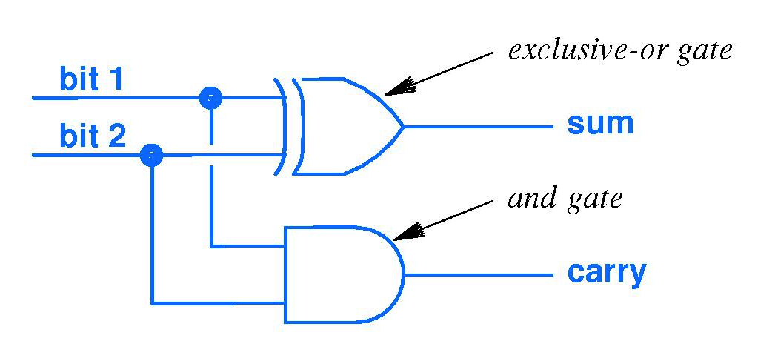
Binary addition and the Half Adder
To start circuit design, try adding just 2 bits (no carry in)
Carry in | Addend | Augend | Sum | Carry out
0 | 0 | 0 | 0 | 0
0 | 0 | 1 | 1 | 0
0 | 1 | 0 | 1 | 0
0 | 1 | 1 | 0 | 1
1 | 0 | 0 | 1 | 0
1 | 0 | 1 | 0 | 1
1 | 1 | 0 | 0 | 1
1 | 1 | 1 | 1 | 1
Addend
Augend

Slide 5
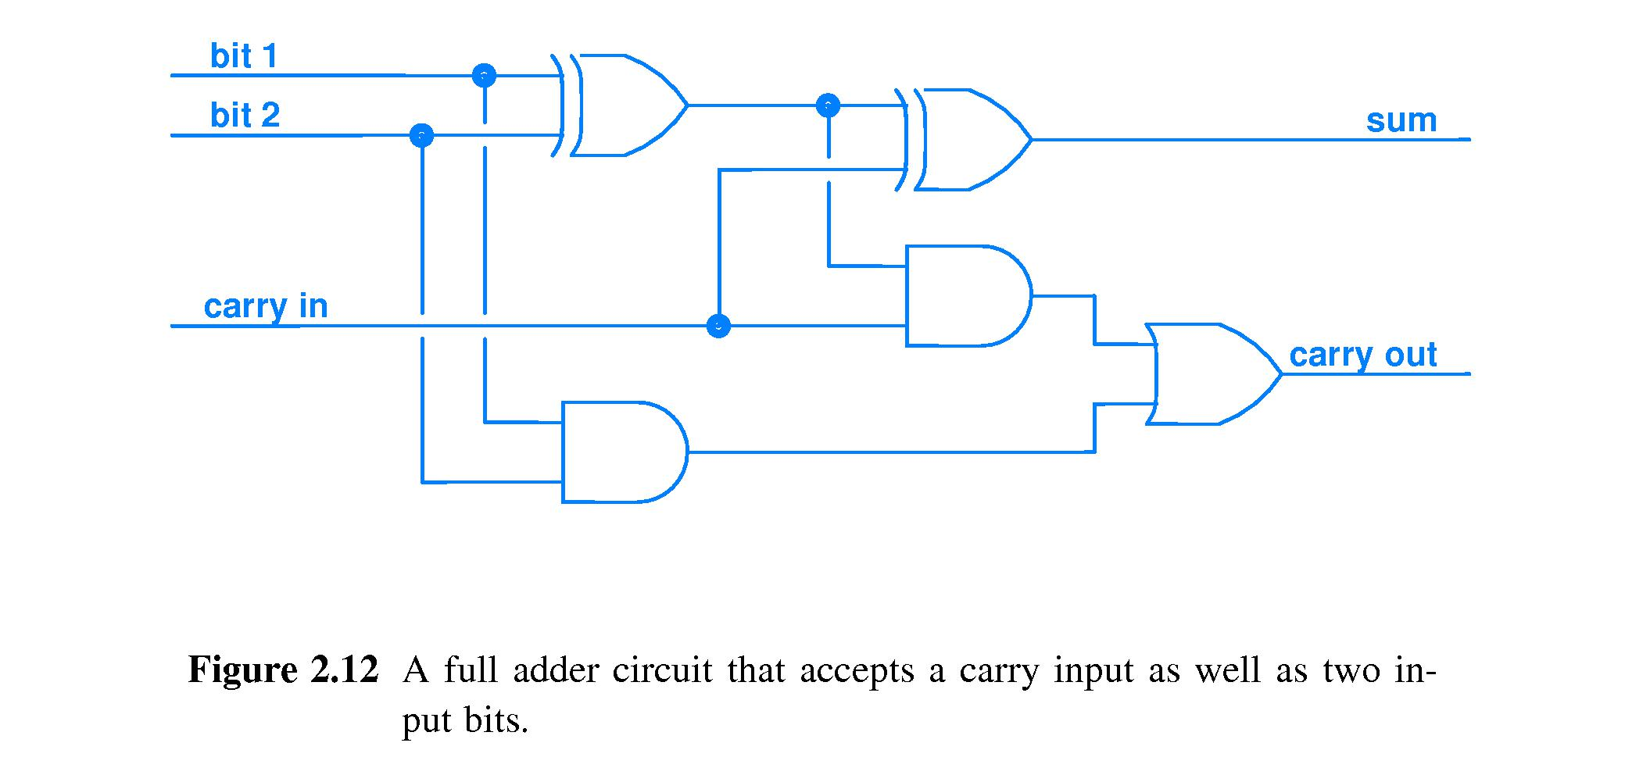
Binary addition – Full Adder
Adds carry in
Addend
Half adder
Half adder
Sum
Augend
(sum of 3-bits)
Carry
Carry
Notes:
Addition we do all the time. Speed of this operation is very important. How many gate delays for this circuit?

Slide 6
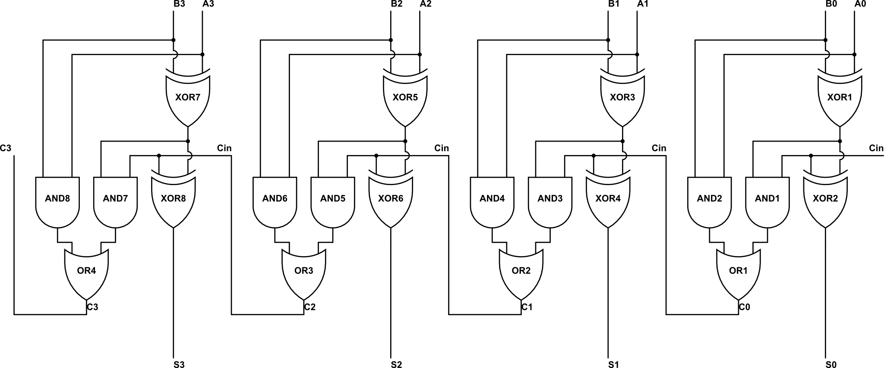
4-bit adder constructed via Replication
Input of 4-bit addend A₃A₂A₁A₀ and augend B₃B₂B₁B₀
Output carry C₃
Carry in
MSB
Output of 4-bit sum S₃S₂S₁S₀
LSB
Circuit propagation delay (units of gate delays) =
0 1 2 3 4 5 6 7 8 9
Notes:
Replication is the HW Engineer’s friend, just like Iteration is the SW developer’s friend.

Slide 7

64-bit ripple-carry adder
Replicate 4-bit ripple carry adder 16 times

Slide 8
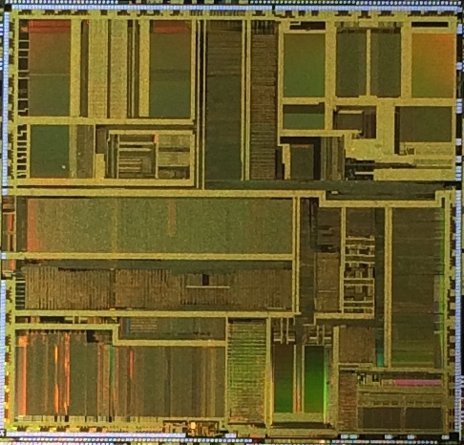

Slide 9
What capability to implement next?
Hardware that can ADD can readily be extended to execute instructions generally: subtract, compare, …
Hardware that can execute our code autonomously (on its own, without us inputting each instruction manually) is the goal
Must have memory hardware to store programs and allow their instructions to be read by the execution circuit

Slide 10
Gate specifications (specs)
To ensure gate operation in a wide variety of environments, extensive engineering and measurement performed
Gate speed is always of interest
Propagation delay – elapsed time from a gate input change until a gate output change
May not be symmetric: Low to high transition T_{PLH} may take longer than H to L, T_{PHL}, or vice versa
Input changes that do not cause an output change do not define T_{PLH} or T_{PHL}

Slide 11
Look 7400 NAND Data Sheet (specs)
Here is the data sheet from Texas Instruments

Slide 12
Logic Circuits
Combinatorial logic – implements functions of logic inputs to generate a result or output (defined by its truth table)
Nice, but a logic circuit will be more powerful if its output can also be a function of time
What does it mean for a function to include time as an input? For a circuit?
Function and circuit behavior will depend on HISTORY

Slide 13

“One time a guy handed me a picture, he said, ‘Here’s a picture of me, when I was younger.’
Every picture of you is when you were younger!” – Mitch Hedberg, paraprosdokian comedian
This photo is a memory.
How can we build a circuit with memory?

Slide 14
Very recent history, a video example
I clap my hands so that you can both
look directly at them to see them moving, and
see them moving in the projected video
Video is a fraction of a second delayed compared to what your eyes see directly
You could say that my video is HISTORIC
Video is history because of signal propagation time in the document camera and projector circuits

Slide 15
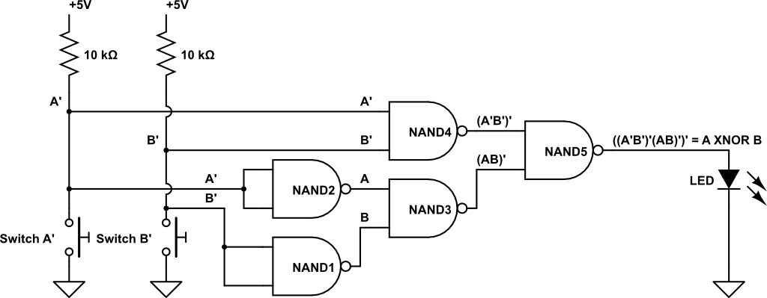
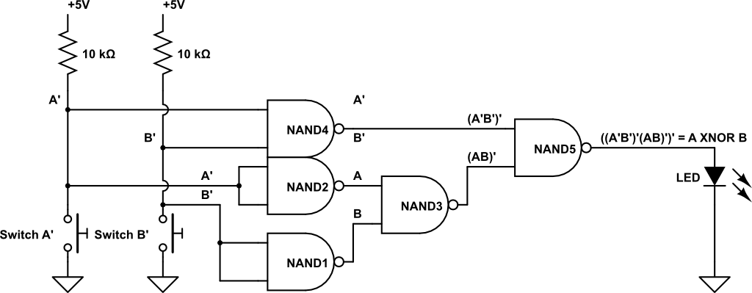
History as location
We can go looking for history in digital circuits
Where is history in our Lab 01 circuit?
Let inputs = Now →
Here is response to the
inputs of
10ns ago
Here is →
20ns ago
Here is → 30ns ago
Here is → 35ns ago
Notes:
First cut at timing depicting needs a tweak. Circuit tweaked by moving NAND4.

